Slide 1
CWRU DRINKS
Mingxuan Ju, Michael Folz, Mark Gross, David Navia

Slide 2
Database Summary
CWRU Drinks is a database meant to help people find places to drink or local events near them.
Its target demographic is for students either looking for places to buy drinks or go to local events, a feasible goal that we would be able to achieve if given the time would be to store data on places to drink/local events near CWRU, and have the app be a resource for local students.
A theoretical application of the database could be a mobile app.

Slide 3
ER Diagram
For the ER diagram tables we tried to include all the information that a student might be interested in when looking for a place to drink (and a little extra info to meet the table requirements).
Examples of these are:
Events various places are hosting
Who will be attending said events
What drinks the place of services Sells/Serves
When the place of service is open
etc.

Slide 4
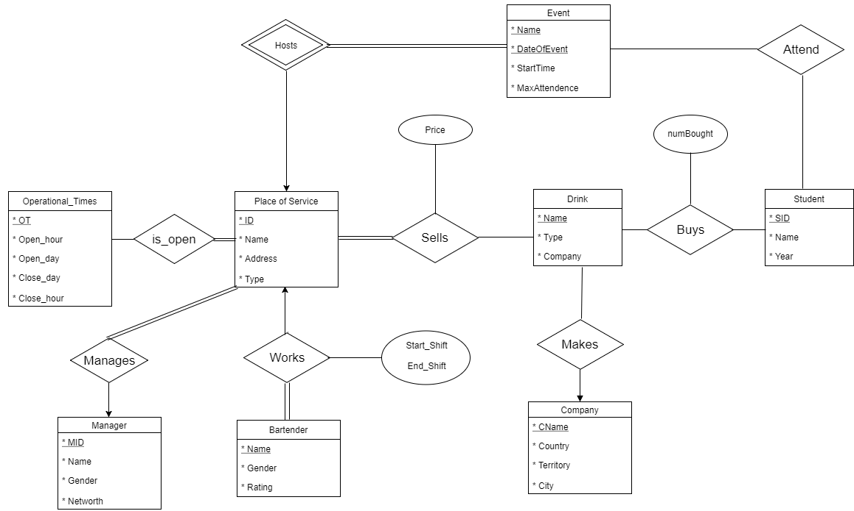

Slide 5
Example Queries
For our example queries we implemented at least one that tested each table in the ER diagram.
We also tested functions such as AVG and except etc.
We have multiple dynamic and static queries, today we will show off a handful of examples.
We’re going to start by showing the queries we made in the command line.

Slide 6
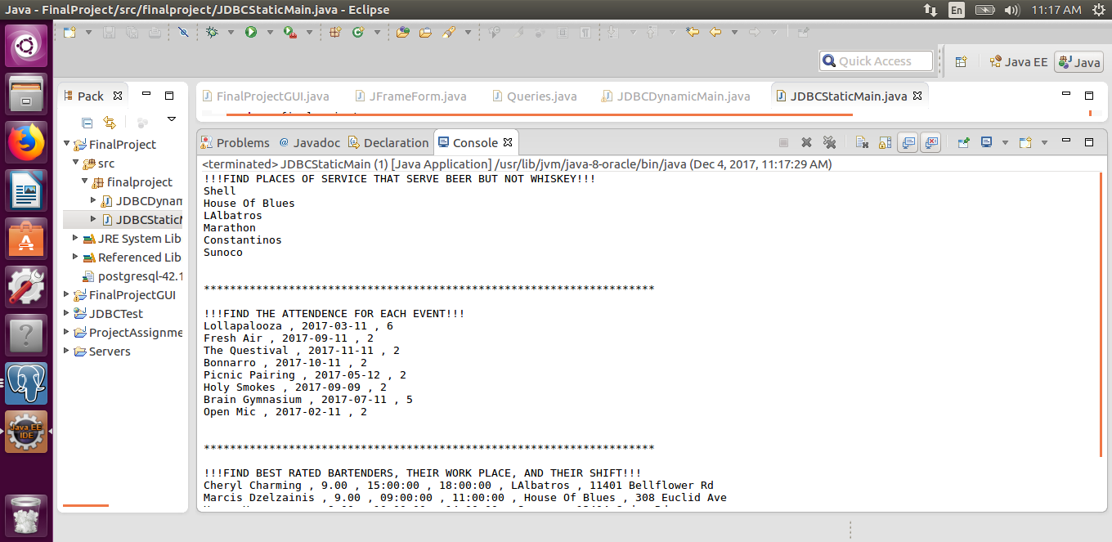
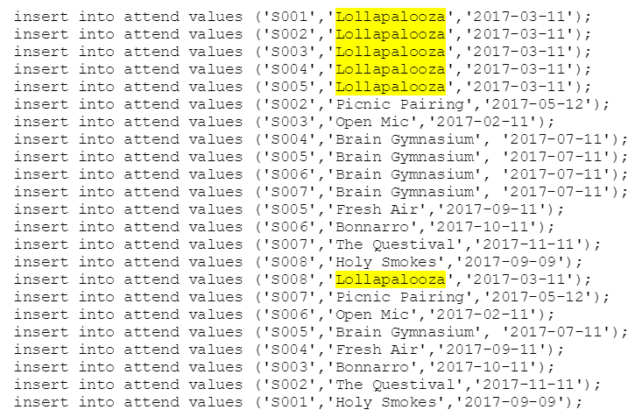
Static Query and Submissions in Table

Slide 7
SELECT e.name, e.dateofevent, COUNT(a)
FROM Event e, Attend a
Where e.name = a.eventname
GROUP BY e.name, e.dateofevent

Slide 8
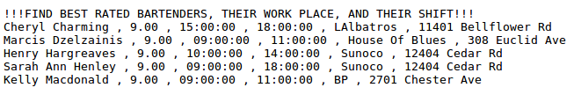
Static Queries cont.

Slide 9
SELECT DISTINCT p.name, p.address
FROM Place_Of_Service p, Drink d, Sells s
WHERE d.type = 'beer' AND
s.drinkname = d.name AND
s.pos_id = p.id
EXCEPT
SELECT DISTINCT p.name, p.address
FROM Place_Of_Service p, Drink d, Sells s
WHERE d.type = 'whiskey' AND
s.drinkname = d.name AND
s.pos_id = p.id
SELECT b.name, b.rating, w.start_shift, w.end_shift, p.name, p.address
FROM Bartender b, Works w, Place_Of_Service p
WHERE b.name = w.bartendername AND
W.POS_ID = p.ID AND
b.rating >= ALL (SELECT rating
FROM bartender)

Slide 10
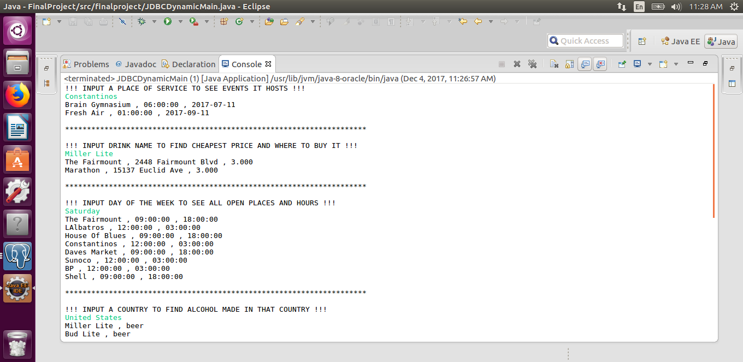
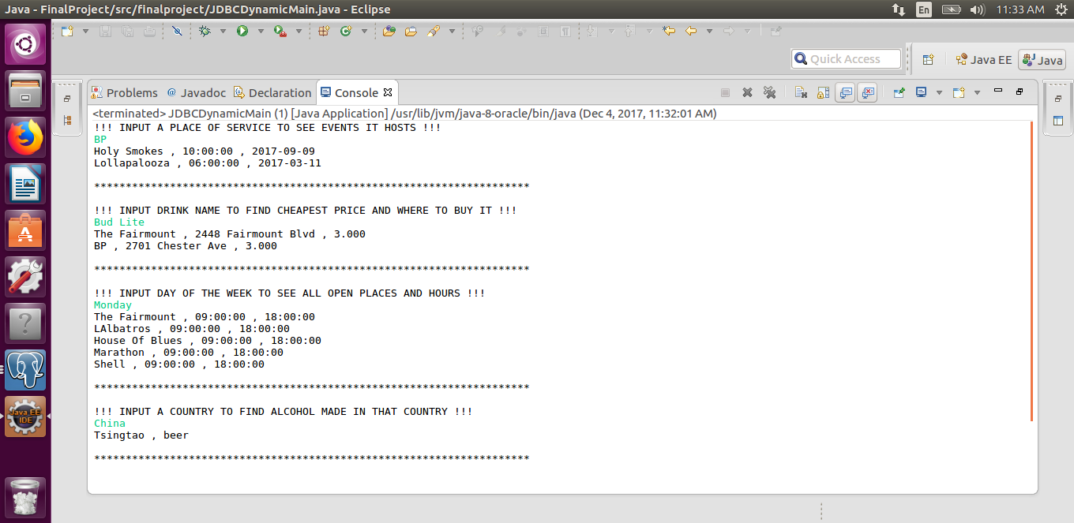
Dynamic Query

Slide 11
SELECT e.name, e.startTime, e.dateOfEvent
FROM Place_of_Service p, Hosts h, Event e
WHERE p.name = 'BP' AND
p.id = h.pos_id AND
h.eventname = e.name

Slide 12
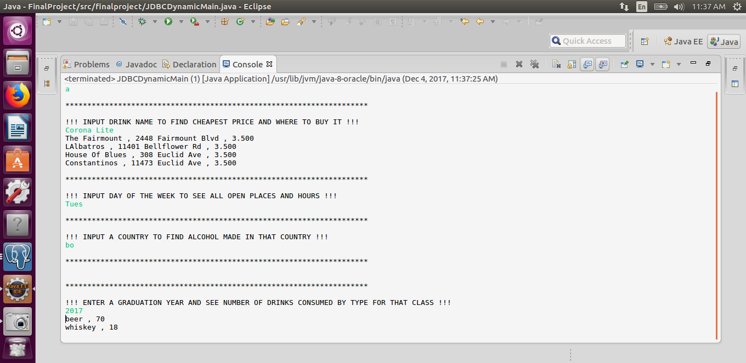
Dynamic Query Cont.

Slide 13
SELECT p.name, p.address, s.price
FROM Place_Of_Service p, Sells s
WHERE s.drinkname = 'Miller Lite' AND
s.pos_id = p.id AND
s.price <= ALL (SELECT s2.price
FROM Sells s2
WHERE s2.drinkname= 'Miller Lite')

Slide 14
Dynamic Query Cont.

Slide 15
SELECT p.name, o.open_hour, o.close_hour
FROM Place_Of_Service p, Operational_Times o, is_Open i
WHERE o.open_day = 'Monday' AND
o.OT = i.OT AND
i.POS_ID = p.id

Slide 16
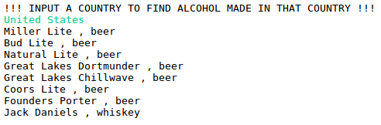
Dynamic Query Cont.

Slide 17
SELECT d.name, d.type
FROM Drink d, Company c, Makes m
WHERE c.country = 'United States' AND
c.cname = m.cname AND
m.drinkname = d.name

Slide 18
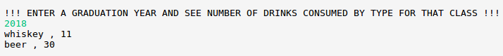
Dynamic Query Cont.

Slide 19
SELECT d.type, sum(b.num_bought)
FROM Student s, Drink d, Buys b
WHERE s.year = 2017 AND
b.sid = s.sid AND
d.name = b.drinkname
GROUP BY d.type

Slide 20
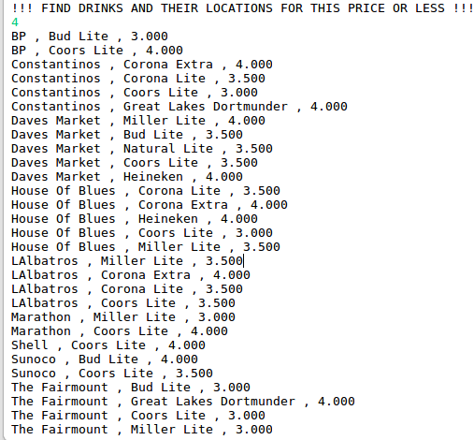
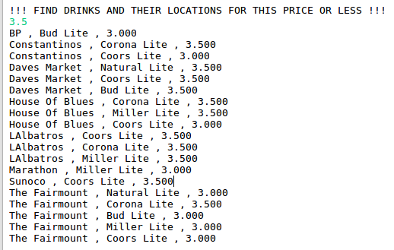
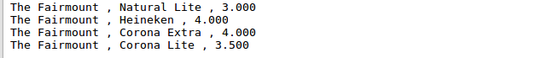
Dynamic Query Cont.

Slide 21
SELECT p.name, s.drinkname, s.price
FROM Place_of_Service p, Sells s
WHERE p.id = s.pos_id AND
s.price <= 3.5
ORDER BY p.name

Slide 22
CWRU Drinks GUI

Slide 23
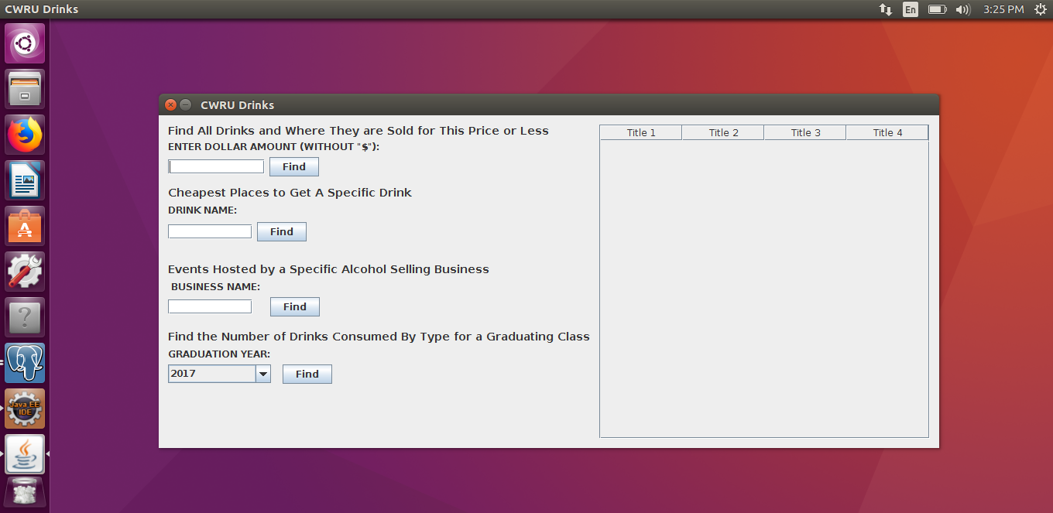
Opening GUI

Slide 24
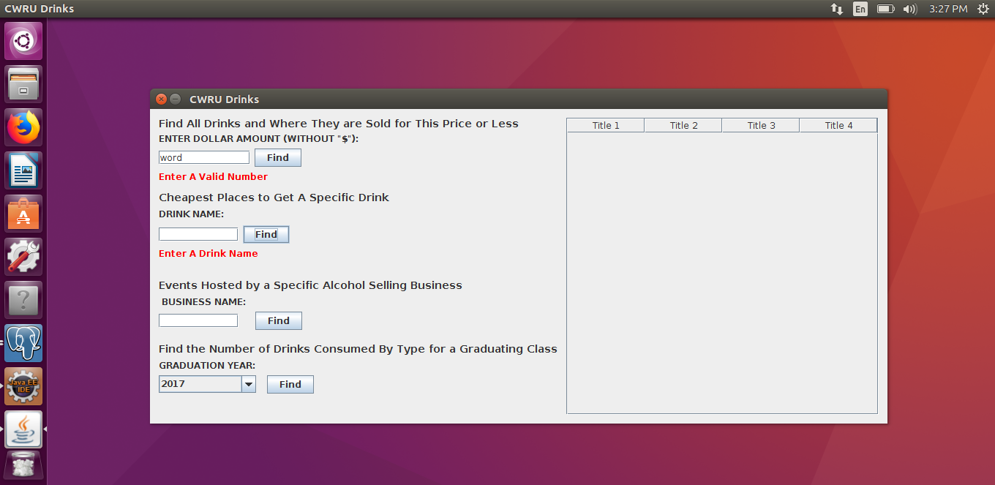
Invalid Input (Error Handling)

Slide 25
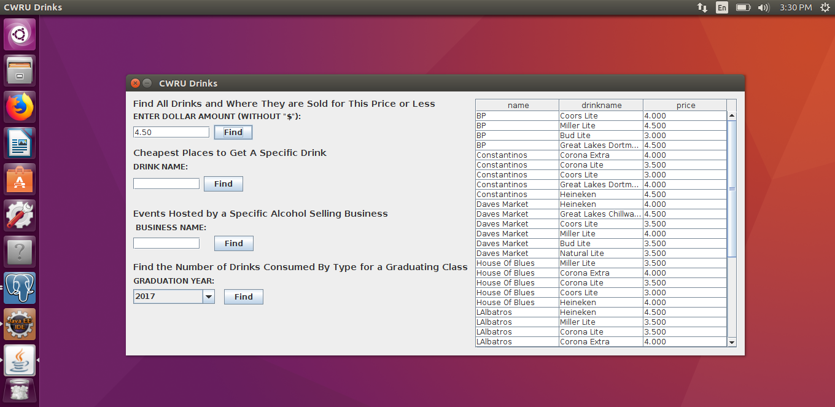
Query 1

Slide 26
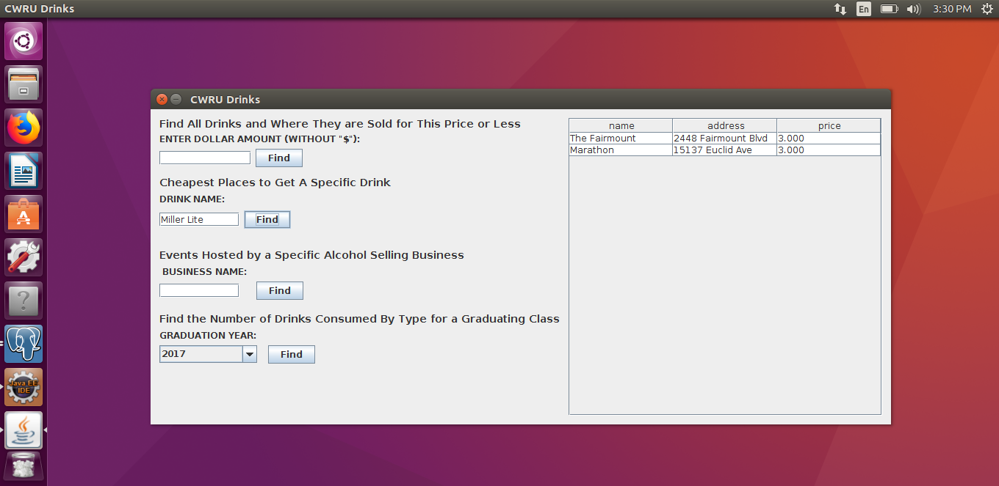
Query 2

Slide 27
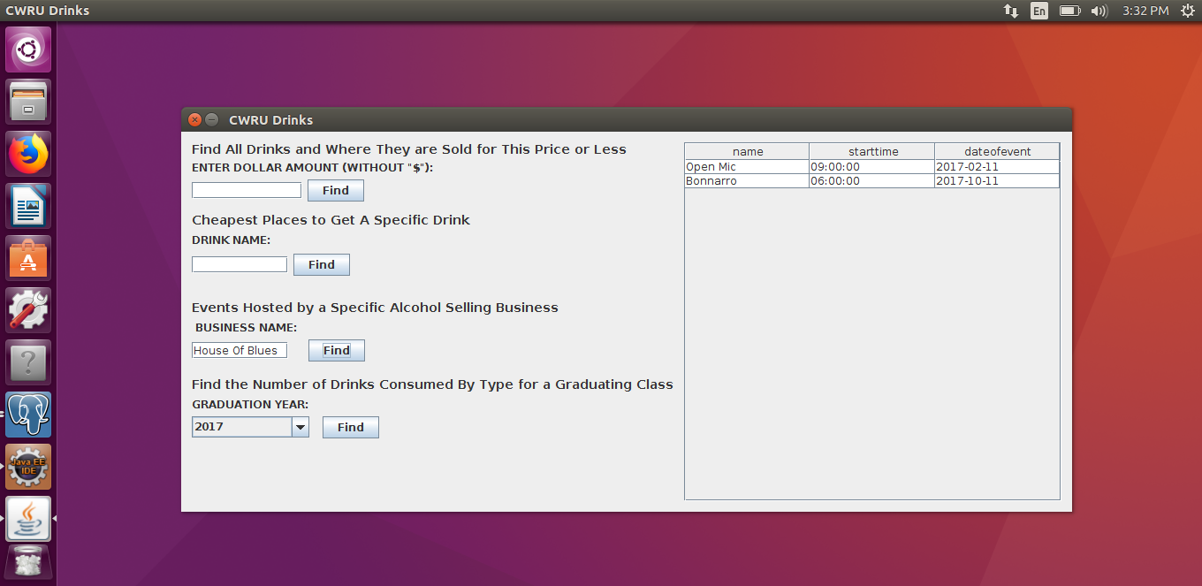
Query 3

Slide 28
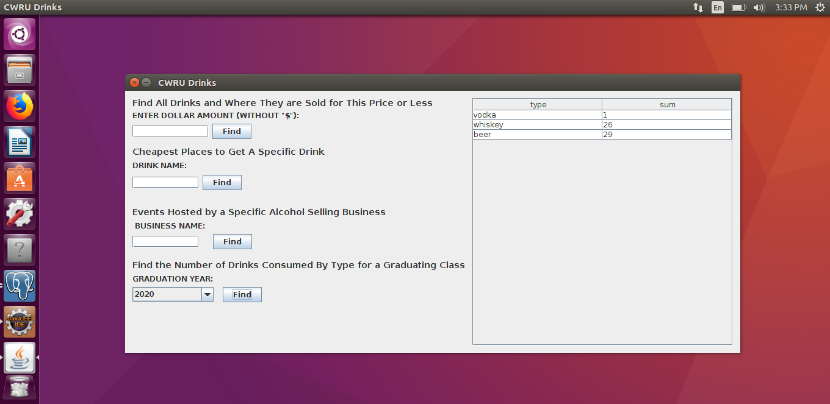
Query 4

